Slide 1
Analog Gauge Reading Using CNN Regression
A Deep Learning Approach for Automated Gauge Reading using CNN regression
Guy Dahan
Advisor: Doron Oizerovich
Tel Aviv University | Captain’s Eye

Slide 2
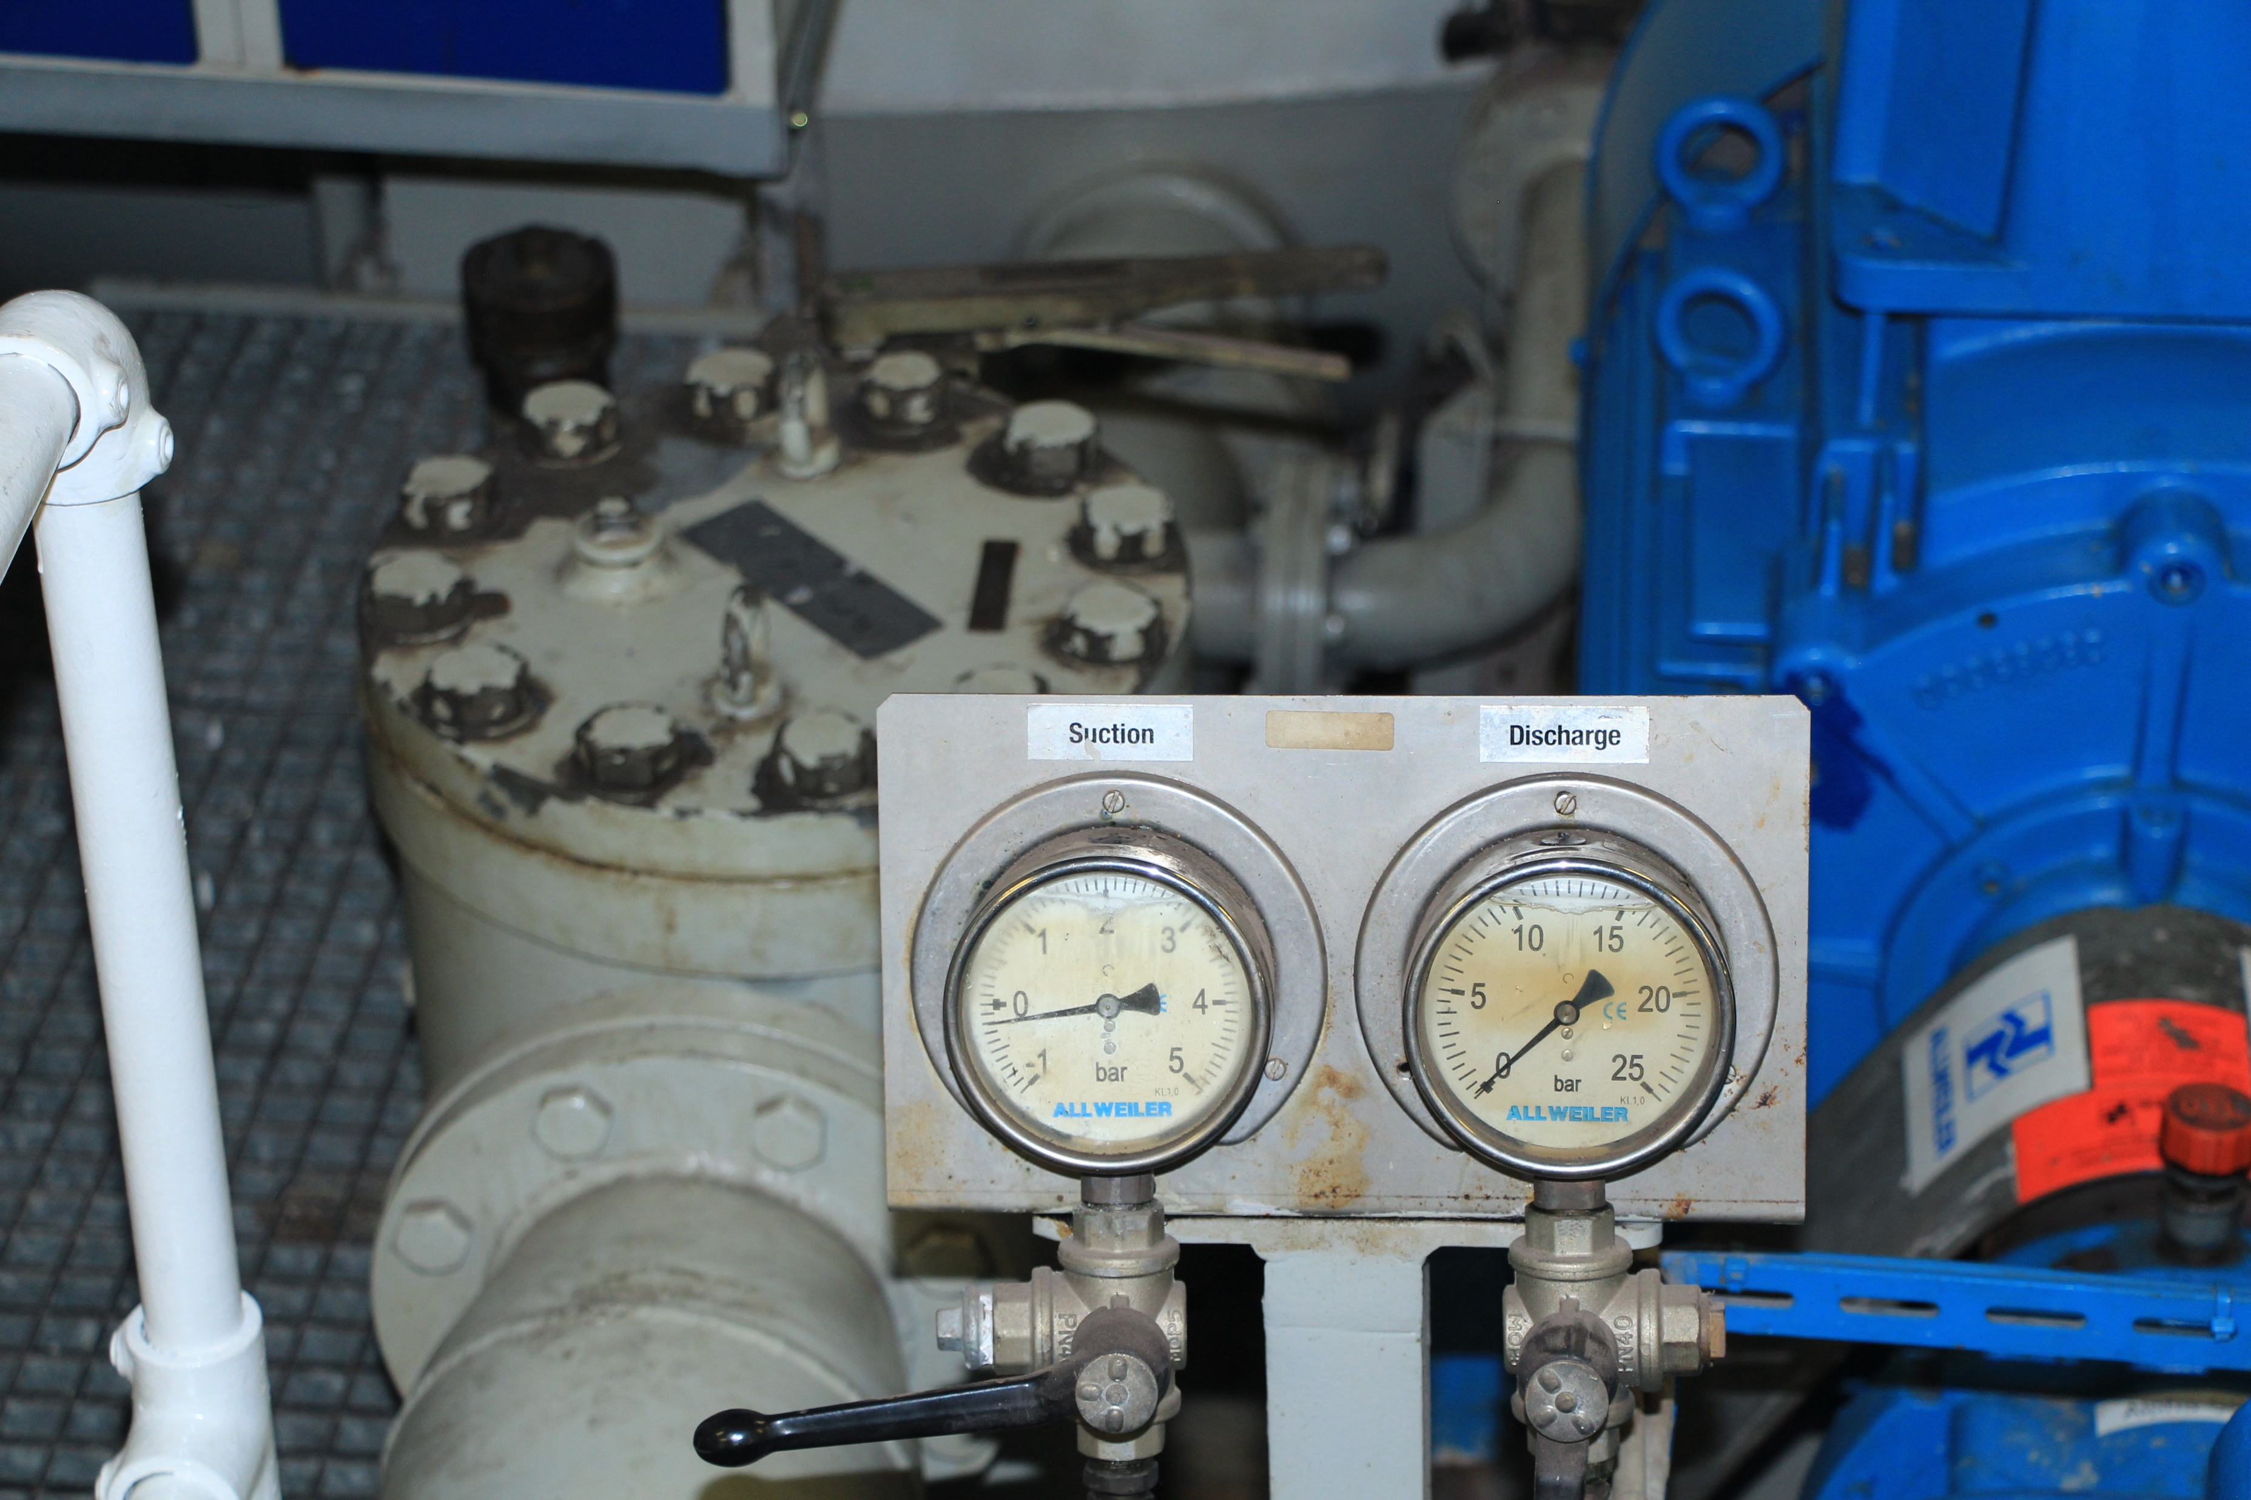
Introduction

Slide 3
The Problem
Challenges | Objectives
An analog gauge installed onboard a ship cannot supply training images | Use synthetic data to create train, validation and test sets
The calibration process must be easy and quick | Create a custom, specific and light UI for calibration
Model must be light and optimized | Create a custom and optimized CNN model

Slide 4
Methods
Light Custom UI
Image editing
1 image only
Training the Model
150 epochs
MSE Loss
Test and Save
weights.pt file and XML calibration
Pytorch CNN custom model

Slide 5
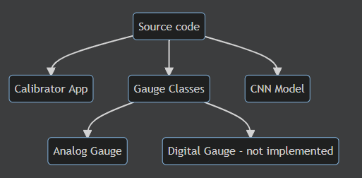
The Project

Slide 6
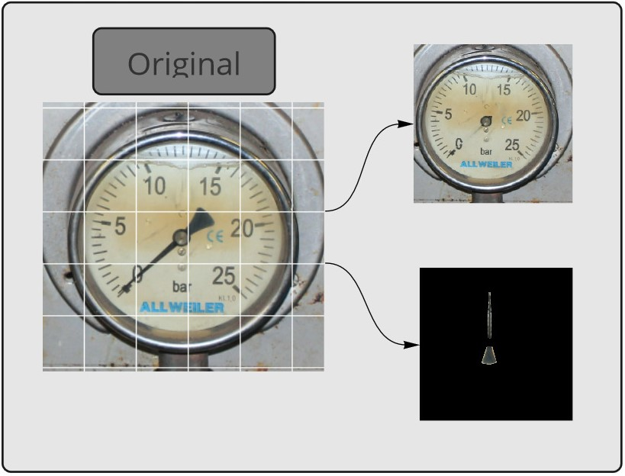
Synthetic Data

Slide 7
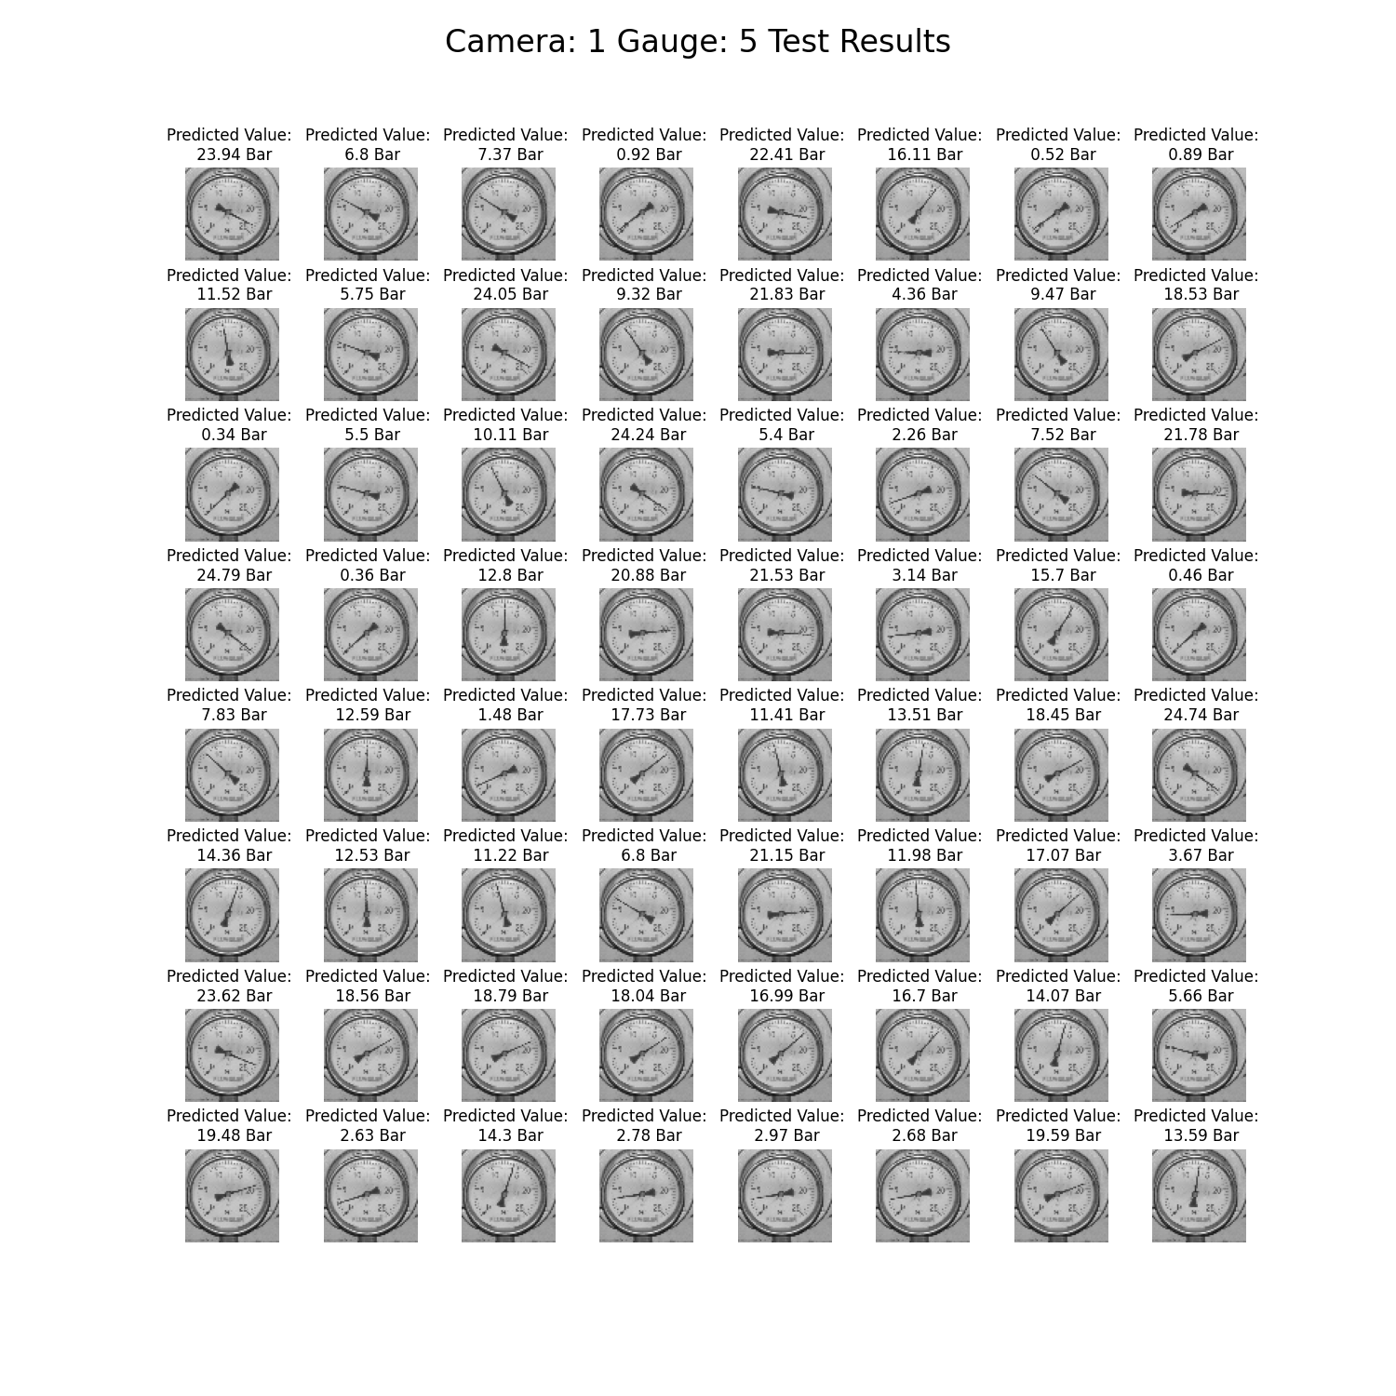
Synthetic Data
Train, Test and Validation sets – all from 1 picture!
Automatic report for visual test
Data is also augmented to enhance training

Slide 8
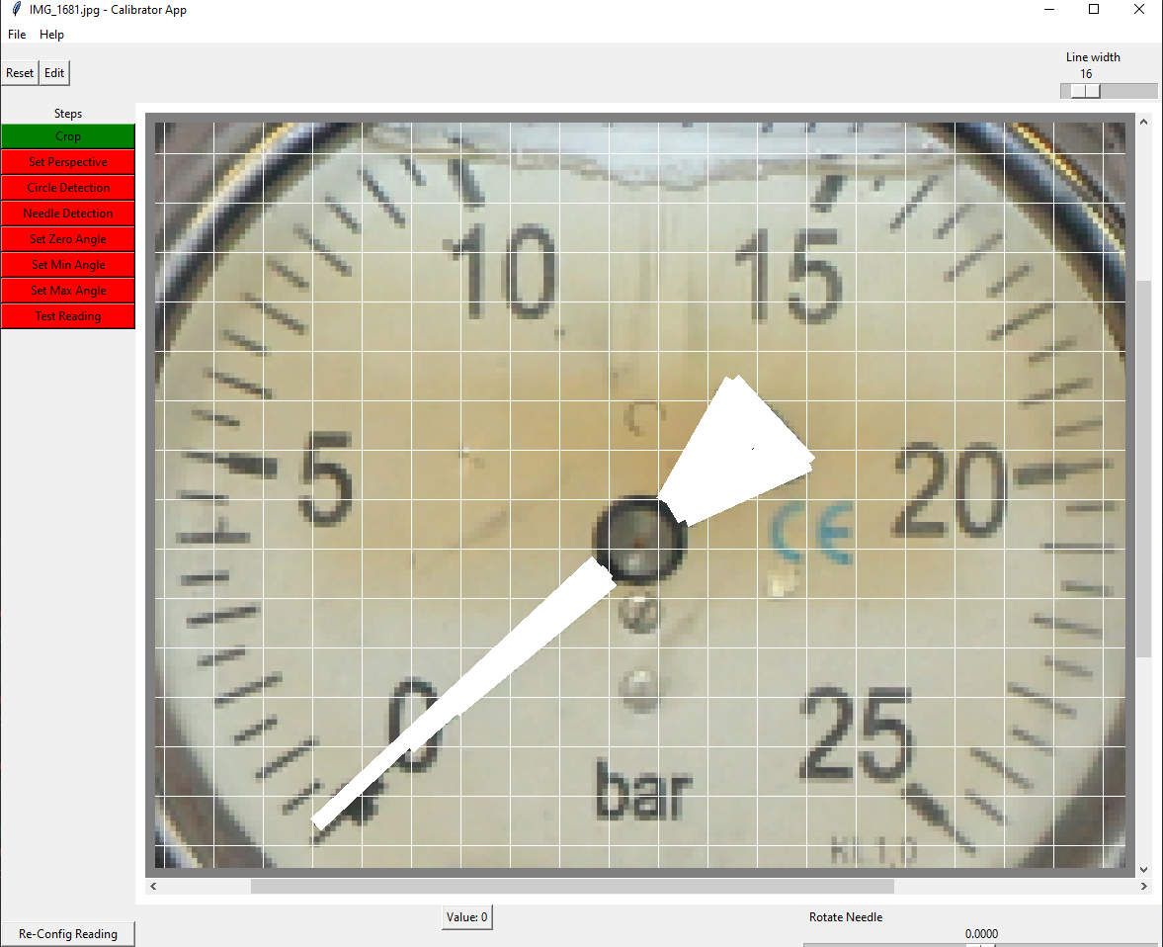
Calibration App
A full UI designed from scratch
Fast
Cross platform (Windows 10, Windows 11, Linux)
Versatile
Full of features

Slide 9

The Model
CNN
Weight initialization using Xavier Uniform
Automatic Epoch Adding and Choosing
MSE Loss
Automatic training reports

Slide 10
Demo
A full walkthrough

Slide 11
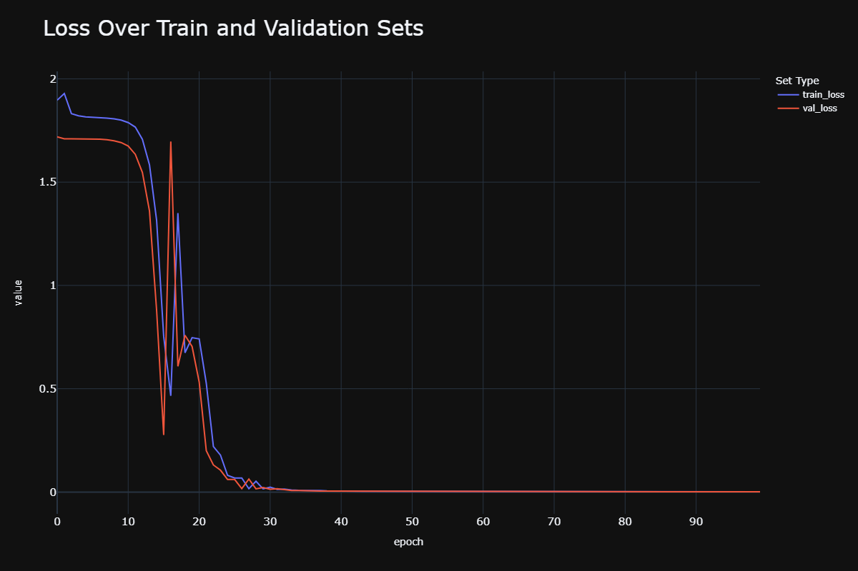
Results

Slide 12
Conclusions
Reading the gauges using the synthetic data is feasible
The process is light and creates a quick reading framework ready for deployment
Future improvements: Augmentation, digital gauges reading

Slide 13
Uses
Ships
Ports
Industrial
Medical

Slide 14
Potential Improvements
Testing Framework
Replace TKinter with PyQt5
Circle Detection
Unit Detection
Python 3.10.4
Gauge Detection
Logging

